Slide 1
Heart attack analysis and prediction using classification modelling
Final project: group A

Slide 2
introduction
we chose heart attack analysis and prediction; we are interested in finding out the likelihood that a patient will have a heart attack or not based on the different conditions and what kind of pain can cause a patient to have heart attack.
The sample size is a 303 patients and it contains 14 variables
We used R to analyze the sample dataset of patients.
We cleaned up our data and used three classification modeling to train, test, and predict the likelihood that the patient will have a heart attack or not.

Slide 3
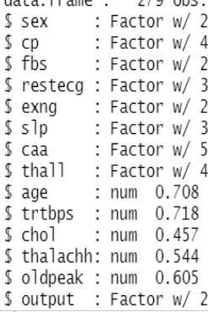
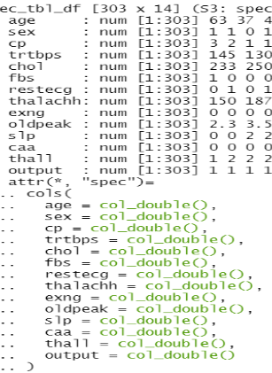
Overview of data structure
we used the str() function to view the structure and discovered that there are categorical variables that were represented as continuous variables “double”.
str()
As.factor()

Slide 4
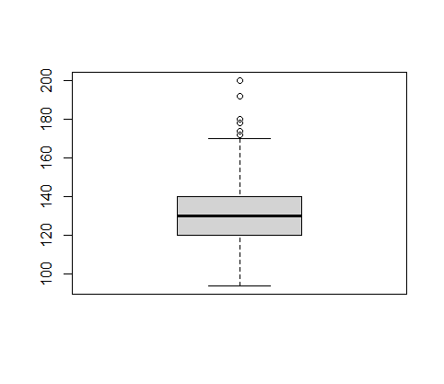
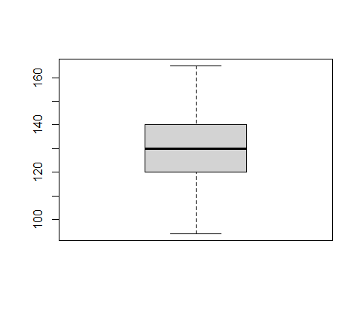
Dealing with outliers
By using boxplot to view the variable, we discovered that there were outliers, and used the interquartile range formula to remove the outliers. This resulted in changing the sample size and structure of the dataset changed.
heart <- subset(dataset,dataset$variable> (Q1 - 1.5*IQR(dataset$variable)) & dataset$variable < (Q3+ 1.5*IQR(dataset$variable)))
boxplot
interquartile range formula

Slide 5
Normalization
normalize <- function(x) {
num <- x - min(x)
denom <- max(x) - min(x)
return (num/denom)
}
nor <-function(x) { (x -min(x))/(max(x)-min(x)) }
Using the formula above we normalized the following variables Age, trtbps, chol, thalachh, and oldpeak from our data that were not normalized

Slide 6
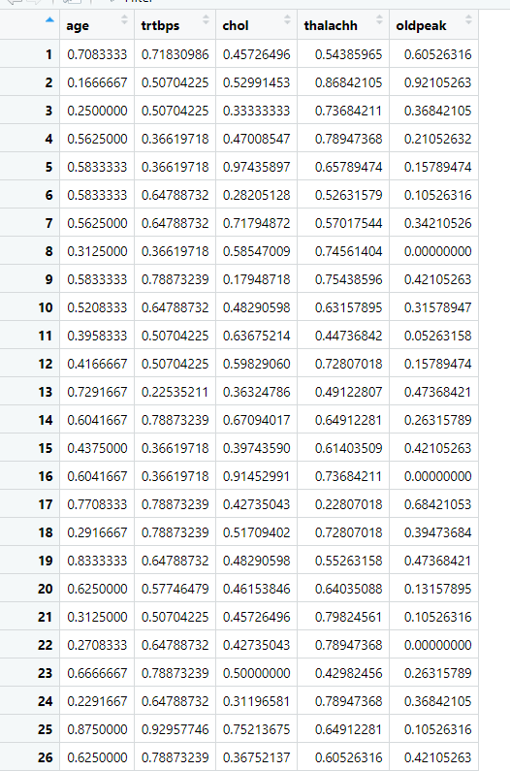
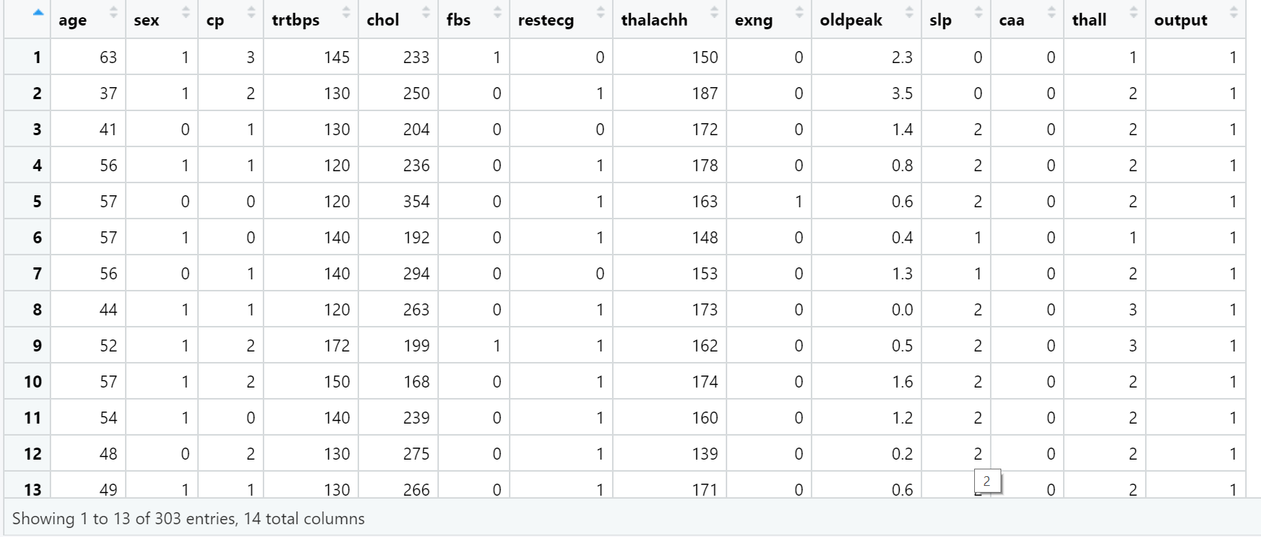
Reorganization

Slide 7
Reorganization
Drop unnormalized variables from the dataset.
Create an ID for both tables.
Merage tables by using ID.

Slide 8
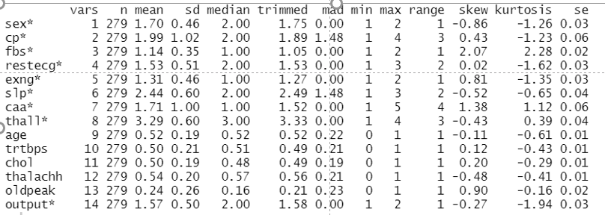
Descriptive statistics after normalization
describe()

Slide 9
Closer Look to Descriptive statistics
right skewed (mean more than median)
Before normalization
after normalization
Left skewed (mean less than median)
before normalization
after normalization

Slide 10
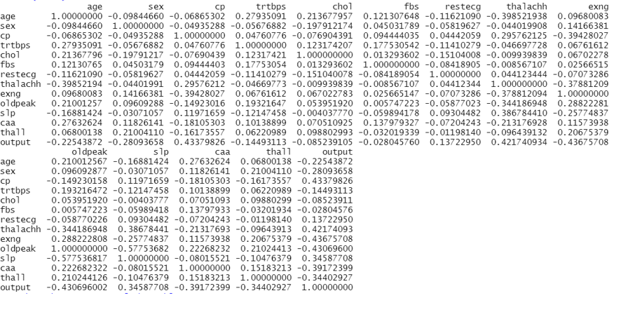
correlations
We looked at the correlation between the output variable and the other variables to determine which one has the strongest/highest positive and negative correlations.

Slide 11
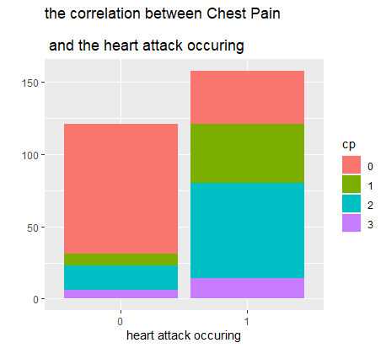

Slide 12
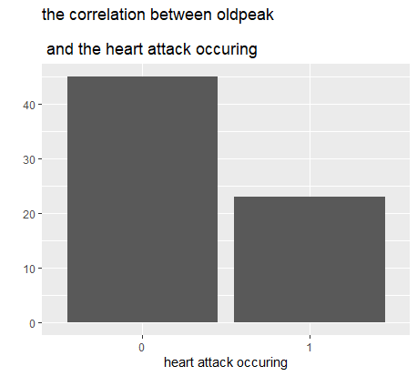

Slide 13
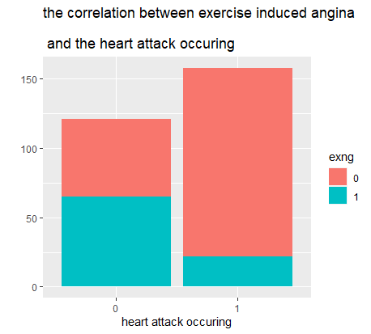

Slide 14
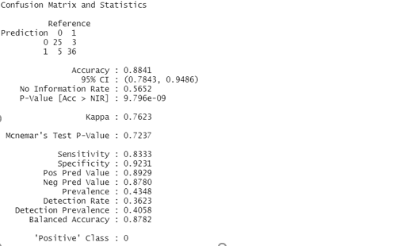
predictive analytics using classification modelling
To predict heart attack occurring, we used knn, cart, and rf models in R. we partitioned our dataset to 75% training and 25% testing.
The knn model produced the highest accuracy of 88.41% and kaapa value of 76.23%.

Slide 15
Conclusion
In conclusion, the study showed that KNN is the best model technique over RF and Cart to predict whether a patient will have a heart attack or not based on certain conditions.

